Slide 1

Web Scraping and Analysis
This project involves web scraping customer reviews to analyze sentiments and trends. Using Python, we extract and clean data, then derive insights on customer satisfaction, common issues, and preferences to improve products and services.

Slide 2
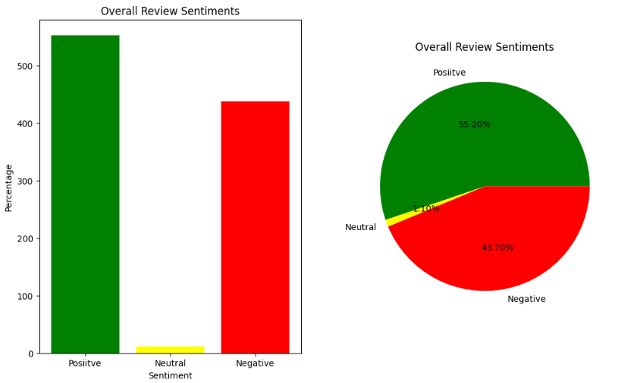
CUSTOMER REVIEW INSIGHTS
Reviewing thousands of customer reviews, gathering feedback, and providing in-depth insights by analyzing them as positive, neutral, and negative.
POSITIVE – 552 (55.20%)
NEUTRAL – 437 (1.10%)
NEGATIVE – 11 (43.70%)

